Slide 1
Facial Expression Recognition Project
Using Cohn-Kanade Dataset
Kottas Vasileios

Slide 2
Introduction
The objective of this project was to classify and understand facial expressions using machine learning techniques. Supervised learning and unsupervised clustering methods were applied to evaluate model performance.

Slide 3
Process Overview
Data Preprocessing: Cleaning and encoding data.
Feature Selection: Reducing dimensions with SelectKBest.
Model Training: Neural network classification with PyTorch.
Evaluation: Accuracy calculation and clustering analysis.
Results Visualization: Confusion matrix and clustering plots.

Slide 4
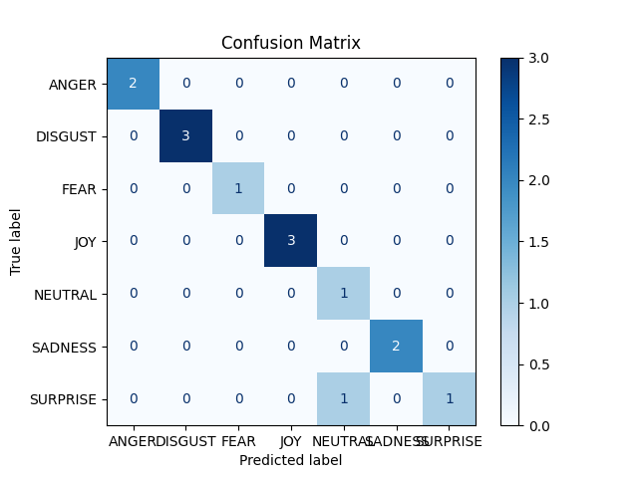
Results: Confusion Matrix

Slide 5
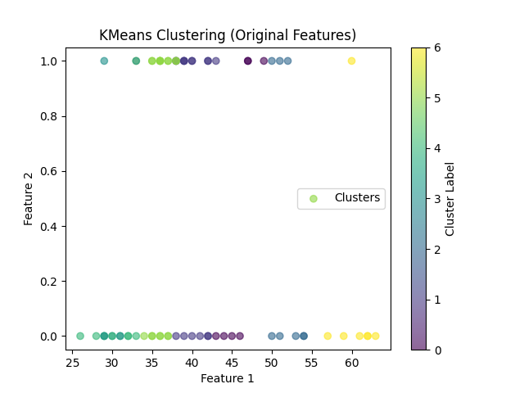
Results: KMeans Clustering

Slide 6
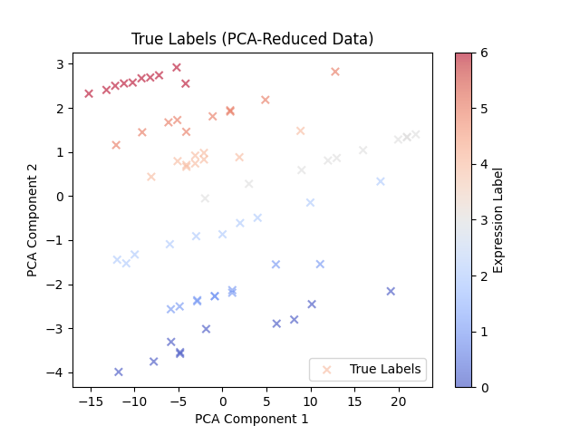
Results: True Labels (PCA-Reduced Data)

Slide 7
Key Insights
The neural network achieved an accuracy of 92.86%.
Clustering accuracy was 17.14%, highlighting challenges in unsupervised learning.
PCA effectively reduced dimensionality for better visualization.
Key features played a significant role in expression recognition.

Slide 8
Conclusion
This project demonstrated the potential of machine learning techniques in facial expression recognition. Future work includes exploring advanced models such as convolutional neural networks and improving unsupervised clustering techniques.

